Slide 1
Pega Cloud E-JPPAP Supplier User Guide
Version 3
George Zhou
Partner Lifecycle l SCM

Slide 2
Contents
What is E-JPPAP & Benefits
Roles & Responsibility
JPPAP Process Flow
Submit PPAP
Submit Further Information
Final Notification

Slide 3
What is E-JPPAP / Benefits
What is E-JPPAP
E-JPPAP is an electronic system that Jabil assign the PPAP requirements to supplier and review the PPAP submitted by supplier.
Benefits of E-JPPAP
By using the E-JPPAP system, we can:
Standardized the process of assigning PPAP to supplier and reviewing PPAP submitted by supplier.
Simplified the interaction between Jabil and supplier.
Automatically remind the PIC to complete the required actions.
Easy to track the activities completed in the JPPAP process.
Easy to retrieve the JPPAP records.

Slide 4

Roles and Responsibility
Requester
Owner
Create the PPAP request
Enter part’s information
Select the Supplier
Enter supplier’s contact
Set the owner for PPAP review.
Select the team member(s)
Define the PPAP requirements
Review the PPAP from supplier
Finally approve the PPAP
Upload signed PSW
Team
Member
supplier
POC
Support owner to review the PPAP
Submit PPAP as per request from Jabil
Submit additional information if required by Jabil

Slide 5
JPPAP Process Flow
Create PPAP Request
Define PPAP Requirements
Submit the PPAP
Finalize the PPAP
Review the PPAP
Review the PPAP
PIC:
Requester
Team Member(s)
Owner
Supplier

Slide 6
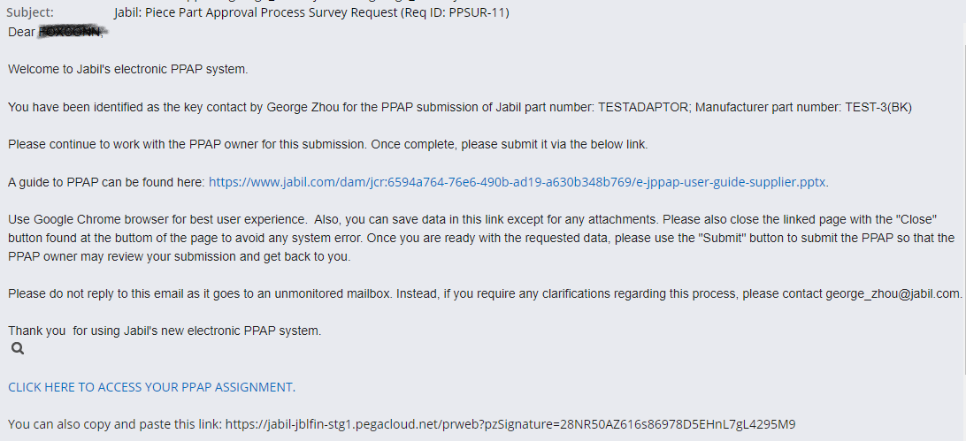
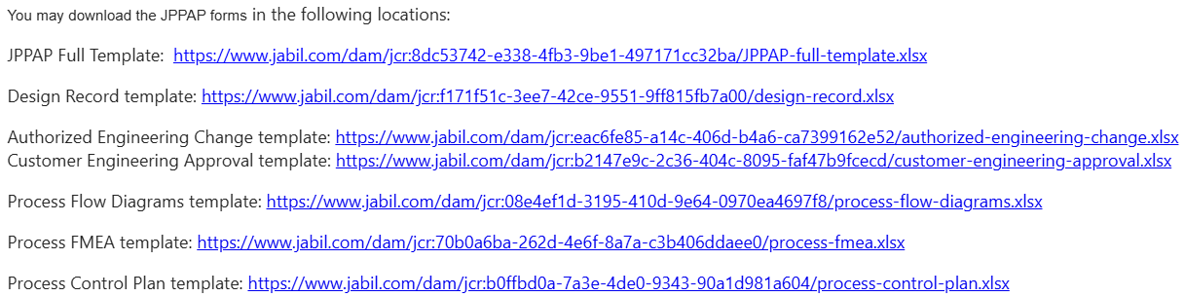
Submit PPAP
Once Jabil assign a PPAP request to supplier, supplier will receive a system notification to submit the PPAP.
Step 1: Open the PPAP assignment by clicking the link or copy and paste the http link to browser.
Notes:
No account and password needed.
If the PPAP be rejected by Jabil, a new notification with new link will be sent to supplier, the original link can’t work anymore.
If supplier need to submit more than one PPAP cases, once submitted one case successfully, must close the browser before open the next case. Otherwise, system will show the case be locked.
Can download Jabil PPAP template via the links:

Slide 7
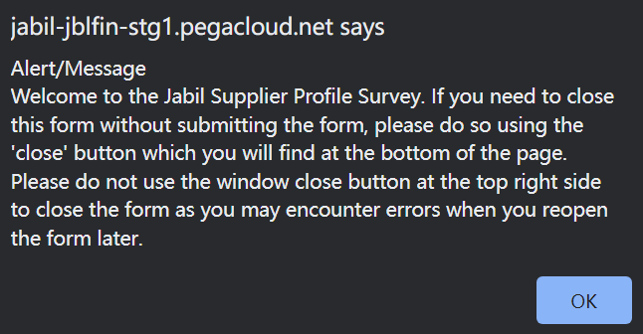
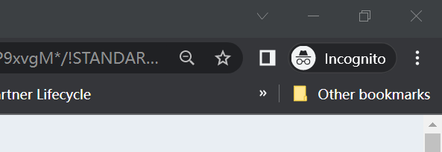

Submit PPAP
Step 2: Read through the important warning message, then click “OK” to close it.
Supplier must follow the correct way to close the window, otherwise the case will be locked for 2 hours.
Wrong way to close the assignment: Close the window by “X” directly.
Correct way to close the assignment: Click “Save”, or “Submit” or “Close” at the bottom of the window firstly, then click “X” to close the window.

Slide 8
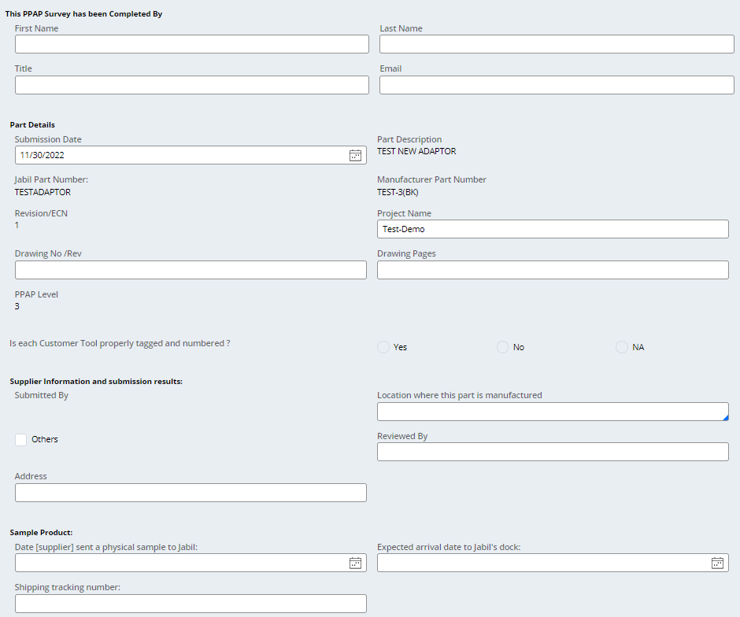
Submit PPAP
Step 3: Fill all the required fields.
Note:
1). Don’t input special characters for any field, such as “”, {,[,&, #, etc.
2). Don’t input multiple rows for one field, especially the “address” and “comments” field. Put all content in one field as one row.
Otherwise, you will fail to submit the case.

Slide 9
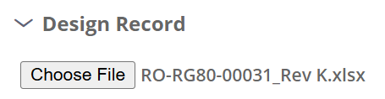
Submit PPAP
Step 4: Upload the required attachments.
Click “Choose File”.
Select the document to upload from your local folder.
Once the document be uploaded successfully, the file name will display.
You can upload the PPAP full template with all documents as one file to any one of the document links and leave the other links to be blank, or you can upload each document to the required document link. Unless the PPAP owner has specific requirement.
The size of each single file must be less than 30 MB. If over the limit, please split it before up-loading.

Slide 10
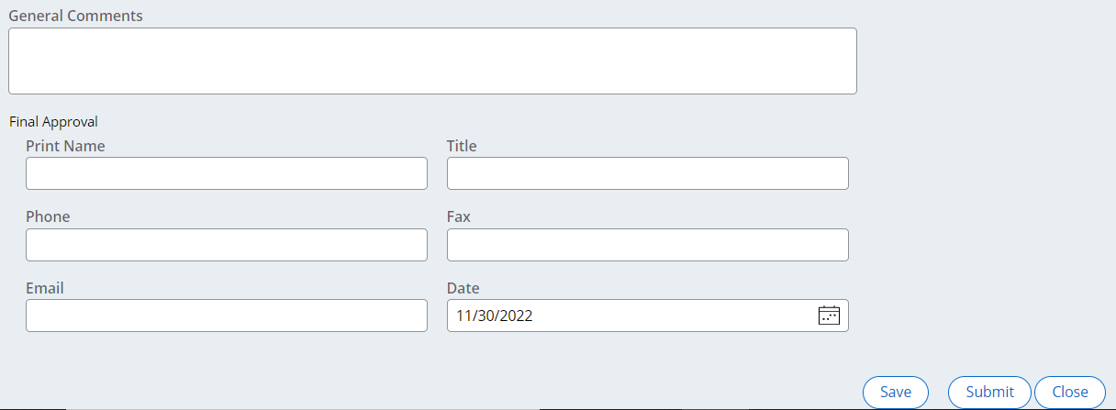
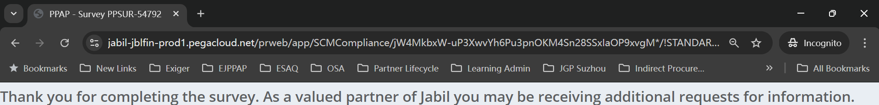
Submit PPAP
Step 5: Fill the general comments and the final approver’s information from supplier. Then submit it.
After submit, system will pop out a “Thank you for…” message, then supplier can close the window by “X”. Next step will be Jabil owner review the PPAP.
Supplier can also click “Save” to save the progress or click “Close” to discard the progress.
Please note:
1). save doesn’t mean the PPAP be submitted. Must click “Submit” for submission.
2). Don’t input special characters for any field, such as “”, {,[,&, #, etc.
3). Don’t input multiple rows for one field, especially the “address” and “comments” field. Put all content in one field as one row.
Otherwise, you will fail to submit the case.

Slide 11
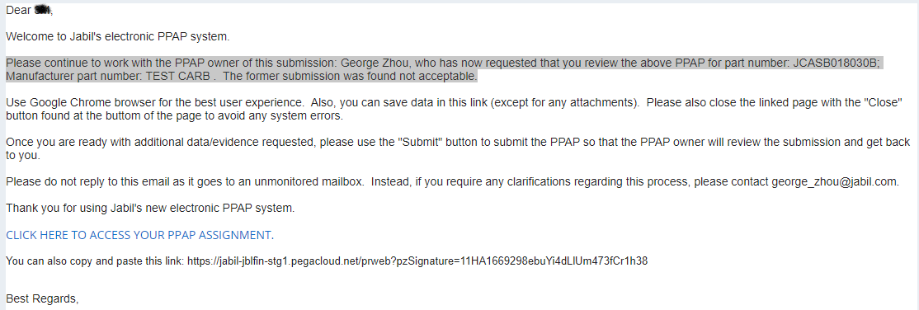
Submit Further Information
In case the PPAP be rejected by Jabil, supplier will receive a system notification to submit further information.
Step 1: Open the PPAP assignment by clicking the link or copy and paste the http link to browser.
Notes:
No account and password needed.
If the PPAP be rejected by Jabil, a new notification with new link will be sent to supplier, the original link can’t work anymore.
If supplier need to submit more than one PPAP cases, once submitted one case successfully, must close the browser before open the next case. Otherwise, system will show the case be locked.

Slide 12
Submit Further Information
Step 2: Read through the important warning message, then click “OK” to close it.
Supplier must follow the correct way to close the window, otherwise the case will be locked for 2 hours.
Wrong way to close the assignment: Close the window by “X” directly.
Correct way to close the assignment: Click “Save”, or “Submit” or “Close” at the bottom of the window firstly, then click “X” to close the window.

Slide 13
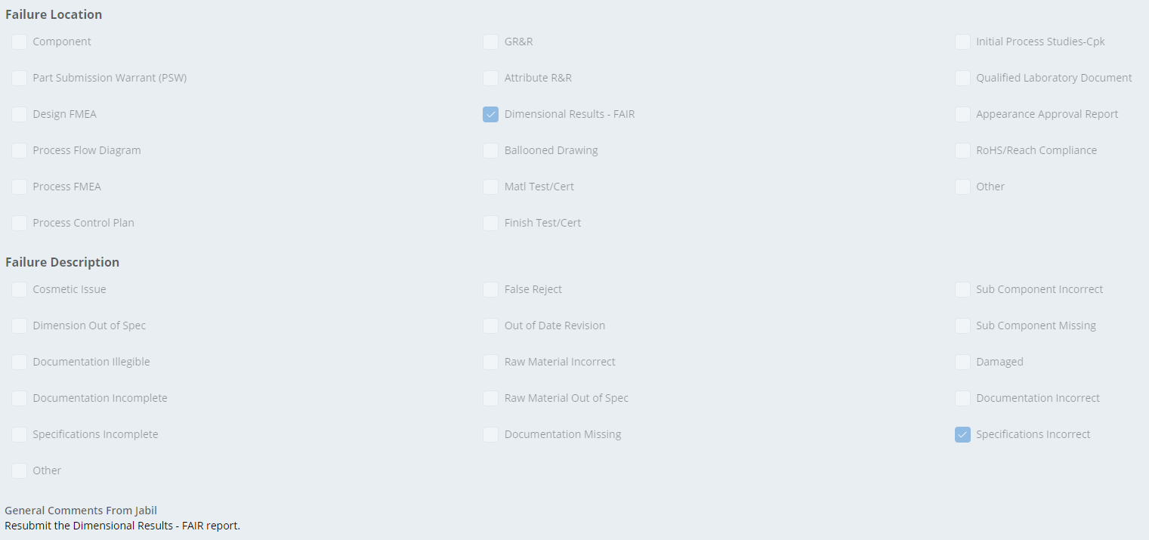
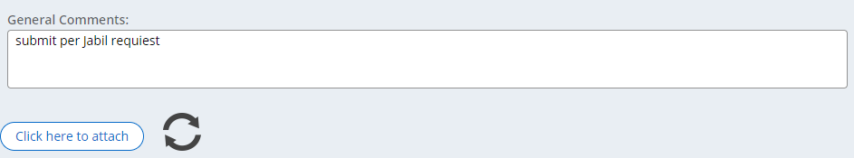

Submit Further Information
Step 3: Read through the failure information and comments from Jabil to understand why the PPAP was rejected.
Step 4: Upload further document(s) that required by Jabil. There may be 2 types of interfaces to upload document.
Interface 1: Click “Click here to attach” to upload, then click the refresh icon after uploading, the file name will show in the list.
Interface 2: Click “Attach” to upload, the file name will show directly.
Step 5: Update the comments and submit.
Interface 1:
Interface 2:

Slide 14
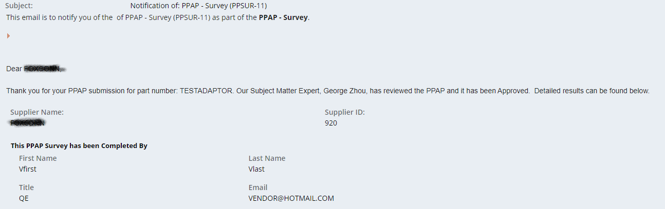


Final Notification
When the PPAP be finally approved by Jabil, supplier will receive 2 notifications:
A notice of the PPAP has been approved.
A notification with the signed PSW attached.

